Slide 1



PUBLIC CRIME DETECTION SYSTEM FOR COMMONERS IN INDIA
PROJECT PROPOSAL

Slide 2





Meet Our Team
Sutharsan.V
Barath Balaji
Nishanth.D
Testing lead
Team Lead
Developer

Slide 3


Objective
To implement a fully embeded Crime detection system using OpenCV.
To make the project in low budget and as user friendly.
To make the project to work on all situations and environment.

Slide 4

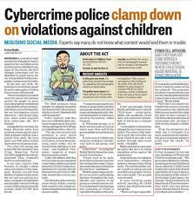
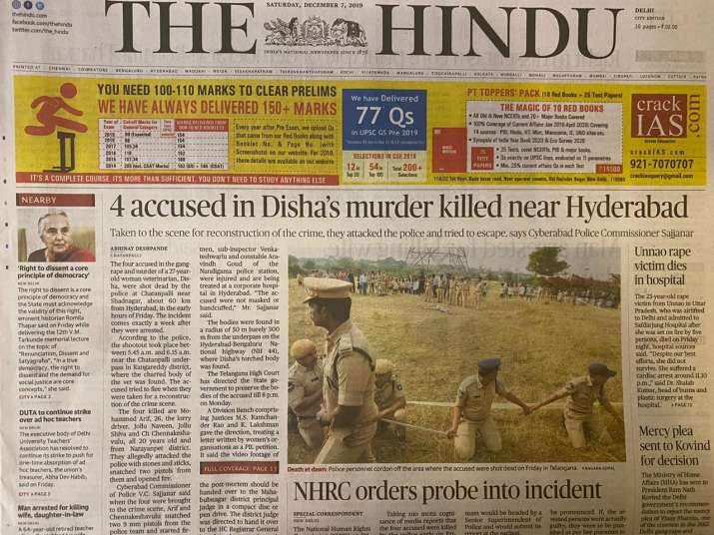

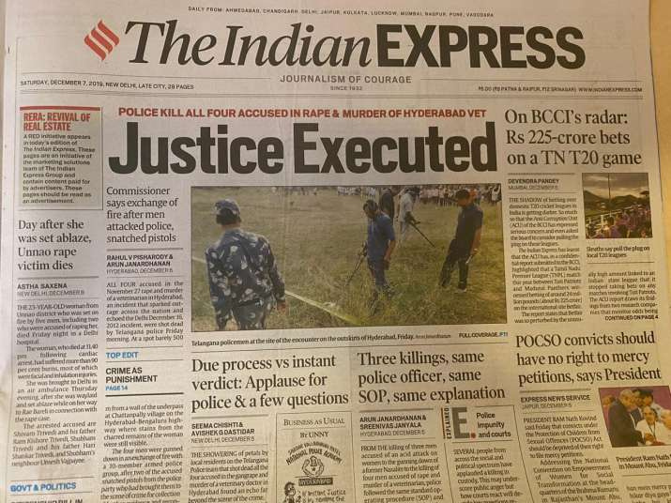


Slide 5


Abstract
Crime detection system using OpenCV, and AI is an innovative solution to overcome and solve numerous crimes happening in and around us. This project helps to identify the culprit in fraction of seconds using AI and OpenCV. .
This project will consist of all the tools and applications needed for each scenario like house robbery, Bike theft, etc. The input is given as image data using real time web cam.The input is given as image data using real time web cam.The technologies used in this project is OpenCV ,AI, ML, Neural Networks (Media pipe).

Slide 6

References
Online att system - https://www.ijert.org/research/online-attendance-system-IJERTCONV5IS09052.pdf
Face detection system - https://arxiv.org/ftp/arxiv/papers/1901/1901.02452.pdf

Slide 7
CHAPTER 1
INTRODUCTION

Slide 8

Introduction
Many surveillance cameras have been installed in stations, commercial facilities, and city areas to deter crime. However, as the number of cameras increases, the volume of video data has also become massive.
These basic actions can be recognized with an average accuracy of 90 percent or more. The proposed Crime Detection System using OpenCV and AI involves detecting movements and identifying the person’s face using computer vision.

Slide 9
CHAPTER 2
LITERATURE REVIEW

Slide 10
S.NO | TITLE | AUTHOR | PROPOSAL
1. | A Survey on Crime Occurrence Detection and prediction Techniques, | Shruti S.Gosavi, Shraddha S. Kavathekar, | predicting crime hotspots is a very important task also applying post-processing will help in lowering the rate of crimes
2. | Analysis for crime prevention using ICT, | Yulihño Ochante-Huamaccto, Francis Robles-Delgado, Michael Cabanillas-Carbonell | a systemic analysis was carried out to determine the importance of how to prevent crime using new information technologies
3. | Theoretical and Empirical Analysis of Crime Data, | Manisha Mudgal, Deepika Punj and Anuradha Pillai, | This paper describes the summary of the different methods and techniques used to identify, analyze and predict upcoming and present crimes.
4. | Crime prediction and intrusion detection with iot and machine learning, | Anirudh Kumar Tiwari Prof.(Dr.) Bhavana Narain | We have taken a condition that if any person is going somewhere and after seeing an accident, when the photo of that accident is taken then automatically it will be sent to nearest police Station.
5. | Crime Detection Technique Using Data Mining and K-Means, | Khushabu A. Bokde, Tiksha P. Kakade, Dnyaneshwari S. Tumsare | The main objective of this paper is to classify clustered crimes based on occurrence frequency during different years

Slide 11
S.NO | TITLE | AUTHOR | PROPOSAL
1. | Criminal face detection system, | shiva tamrkar | This project aims to build a automated Criminal Face Detection system by levering the human ability to recall minute facial details
2. | Empirical Analysis for Crime Prediction and Forecasting | Wajiha safat , Sohail asghar, Saira andleeb gillani | Despite considerable research efforts, yet there is a need to have a better predictive algorithm, which direct police patrols toward criminal activities.
3. | Survey on crime analysis and prediction using data mining techniques | H. Benjamin Fredrick David and A. Suruliandi | Many approaches for analysis and prediction in data mining had been performed. But, many few efforts has made in the criminology field.
4. | survey on video surveillance crime activity recognition | K Kishore Kumar | This survey is useful to improve the crime detection techniques using video surveillance. Moreover, it is a useful tool to gather information
5. | Literature Survey on Criminal Identification | Akshay Rathod, , Rushikesh Sawant, Ashish Choudhary | In this paper, literature survey of crime analysis using DBSCAN clustering on crime dataset is done.

Slide 12
CHAPTER 3
SYSTEM ANALYSIS

Slide 13

SYSTEM ANALYSIS
It is evident from the research of the existing systems that there is a need for advanced and most feasible version for the crime detection system. The solutions which are currently available may provide a wide area of knowledge and satisfy the urgent needs of people. It’s to be believed that the current technologies have multiple tech solutions enabled which can be challenging . Python has been proven to implement latest technologies with the help of modules such as OpenCV for crime detection. Python’s easy to understand code complexity and inbuilt modules makes it a feasible choice for programmers. Imbibing the likes of HTML,CSS & BOOTSTRAP, provides users a platform for accessing our application using website.

Slide 14

Advantages
Enabling the project with Python improves Productivity and increases Versatility
ADABOOST algorithm reduces the time complexity of the process.
Highly accurate
Provides high security with alarms

Slide 15
CHAPTER 4
SYSTEM REQUIREMENTS

Slide 16





Operating system
Windows 8,10,11
Web browser
Google chrome/Firefox/Opera
SYSTEM REQUIREMENTS
Language(UI)
HTML, CSS, JS, Bootstrap
Text editor
Visual studio

Slide 17
Processor
INTEL CORE I7 - 7th GEN or HIGHER
Processor speed
Min 1ghz, recommended 2ghz or more
SYSTEM REQUIREMENTS
Camera
1.3 MP or higher
Memory(RAM)
Min 8GB, recommended 8GB or above

Slide 18
CHAPTER 5
ARCHITECTURE DIAGRAM

Slide 19
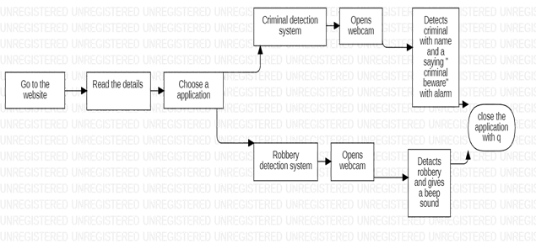
Architecture diagram

Slide 20
CHAPTER 6
SYSTEM MODULES

Slide 21
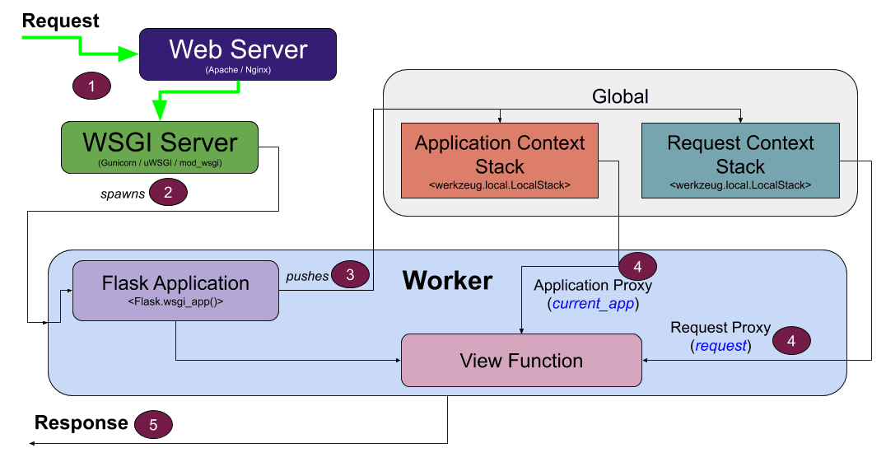
Flask module
The data is received by python application and the data is analyzed respective to the purpose of the application. The further process will be taken care of GET and POST requests simultaneously. GET request is used to collect the input from the user.

Slide 22
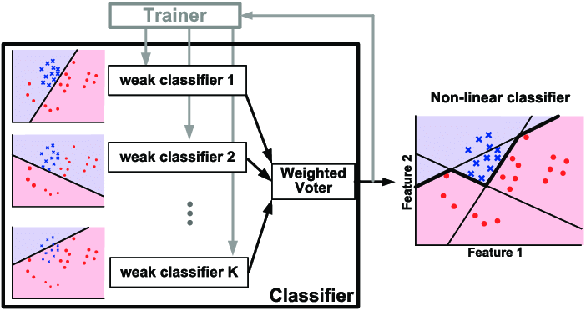
This algorithm has a preprogrammed trainer inbuilt with weak classifiers. The weak classifiers help to classify the images in the application. It’s a supervised learning and it has already pre trained data inserted. OpenCV has a module named HAAR Cascade classifier. ADABOOST is hidden under HAAR cascade classifier. The HAAR cascade is a powerful algorithm which uses edge or line detection to detect the face
ADABOOST MODULE

Slide 23
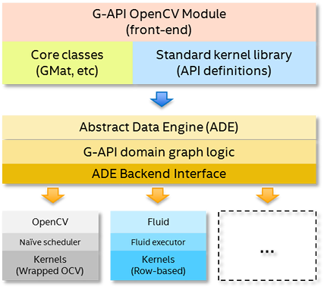
Open CV is a python module which is used in applications which uses face comparisons. OpenCV has a front end of G-API OpenCV Module. The front end uses Core classes of GMat and standard kernel library of API definitions. The data is sent to abstract data engine (ADE). The data is than analyzed using G-API domain graph logic and ADE Backend interface.
OPEN CV MODULE

Slide 24
CHAPTER 7
IMPLEMENTATION

Slide 25

Steps for implementation
Create virtual environment and implement flask.
Create robbery detection system.
Create criminal detection system
Implementation of flask.
Create UI
Create landing page
Create database
Deploying the system in python anywhere

Slide 26
CHAPTER 8
Result & Discussion

Slide 27
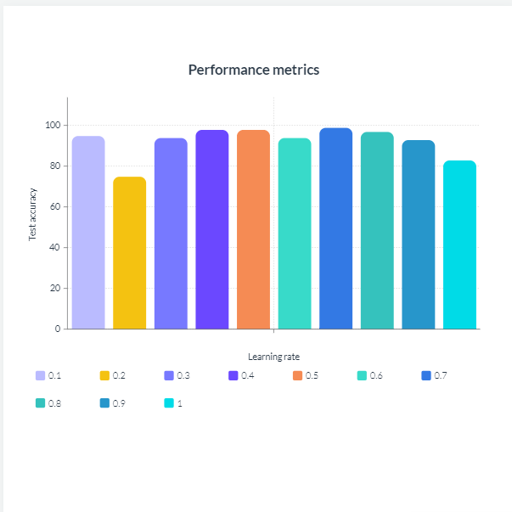
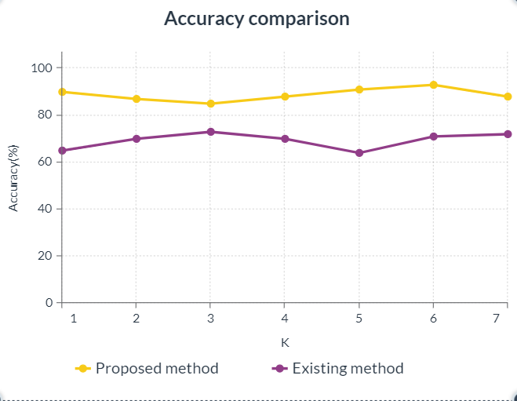
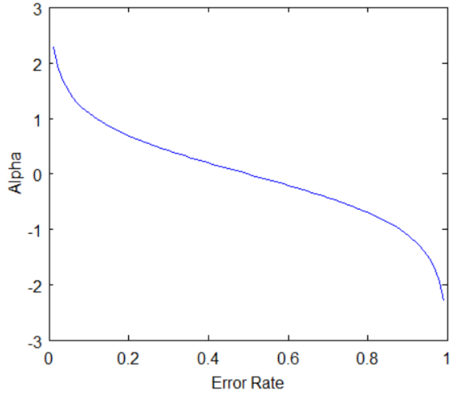
Ada boost Classifier algorithm combines weak classiffier algorithms to create a strong classifier. The accuracy rate of this algorithm will be high when comparing to other algorithms. After training a classifier at any level the Adaboost algorithm assigns weight to each classifier based on accuracy to categorize the classifier into weak and strong.
Data analysis

Slide 28
CHAPTER 9
Conclusion

Slide 29

Conclusion
The public crime detection system for commoners helps all kind of public in residential areas and in public places too. This system is highly effective and gears the nation security above the existing systems. This system is also easy to maintain, and it gives an ease of access to all the users. This paper explains about the deployment of criminal detection system, Modules integrations, Webcam integrations and much more. This is a very useful project as it can protect our homes and nation. The website is quick responsive, fast, and feasible.

Slide 30
CHAPTER 10
Future enhancements

Slide 31

Future enhancements
Future enhancements
• The addition of systems like bike theft detection system, Pickpocket detection system, etc. will be the enhancements for this project.
• Advanced machine learning algorithms will be implemented to reinforce accurate predictions.
• The system will be reinforcing with certain advanced optimization techniques to improve speed and reduce page loading time.
• The ease of access will be improved

Slide 32
APPENDIX 1
Sample coding

Slide 33

Coding implementation
The code is entirely coded by python.
The packages termed as flask, openCV has been implemented.
The frontend is coded using html,css,js,bootstrap,etc.

Slide 34

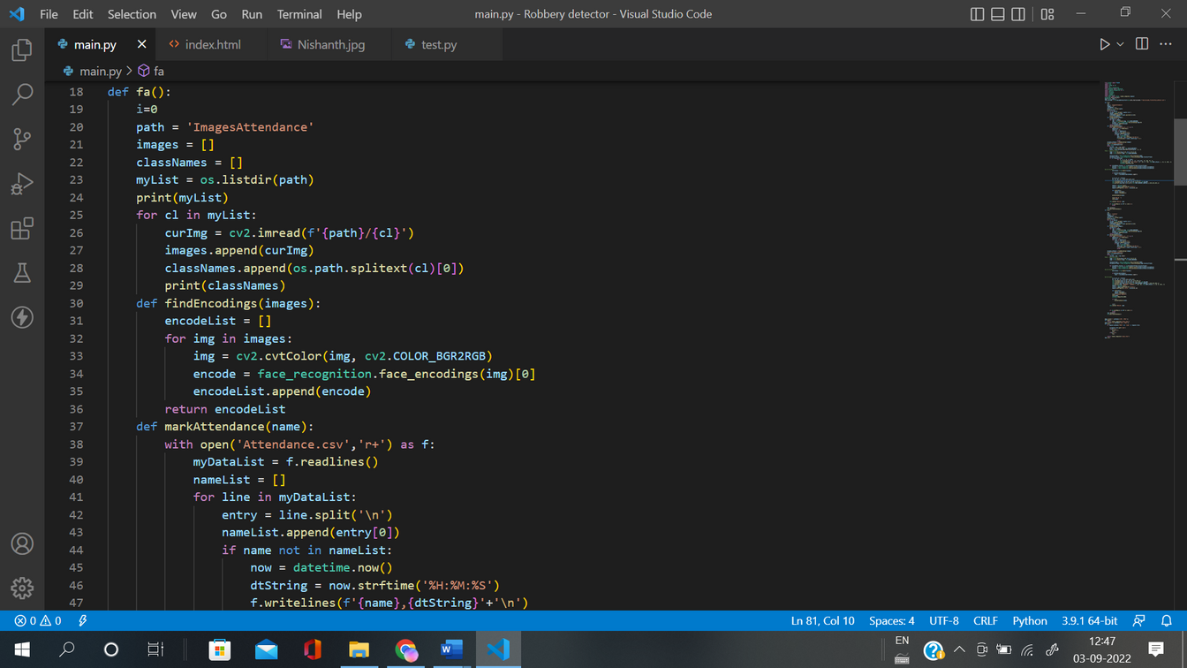
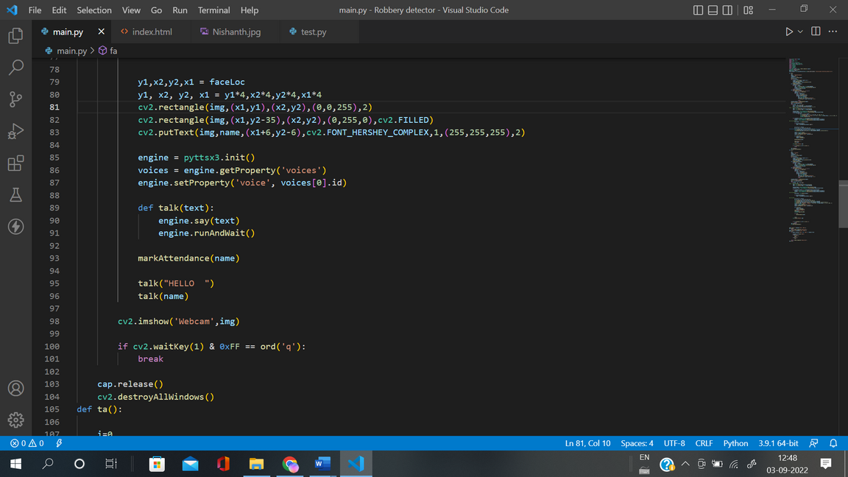
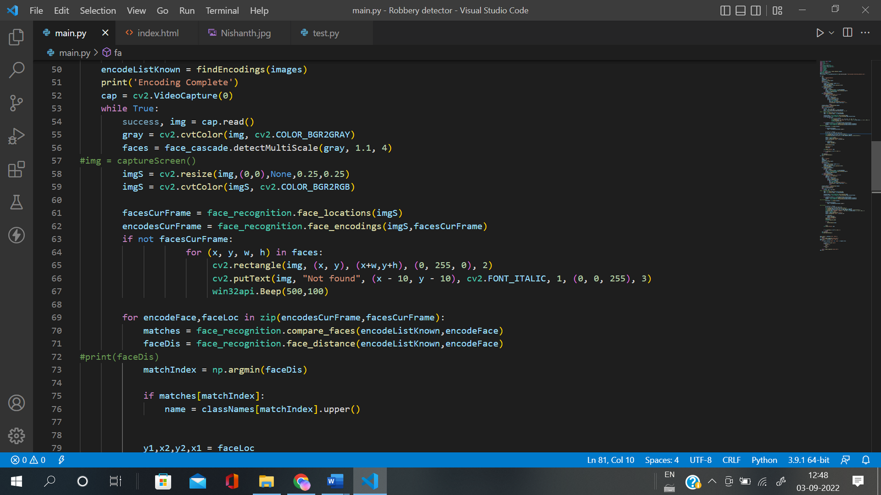

Slide 35
APPENDIX 2
Sample output

Slide 36






CYBERSPY

Slide 37

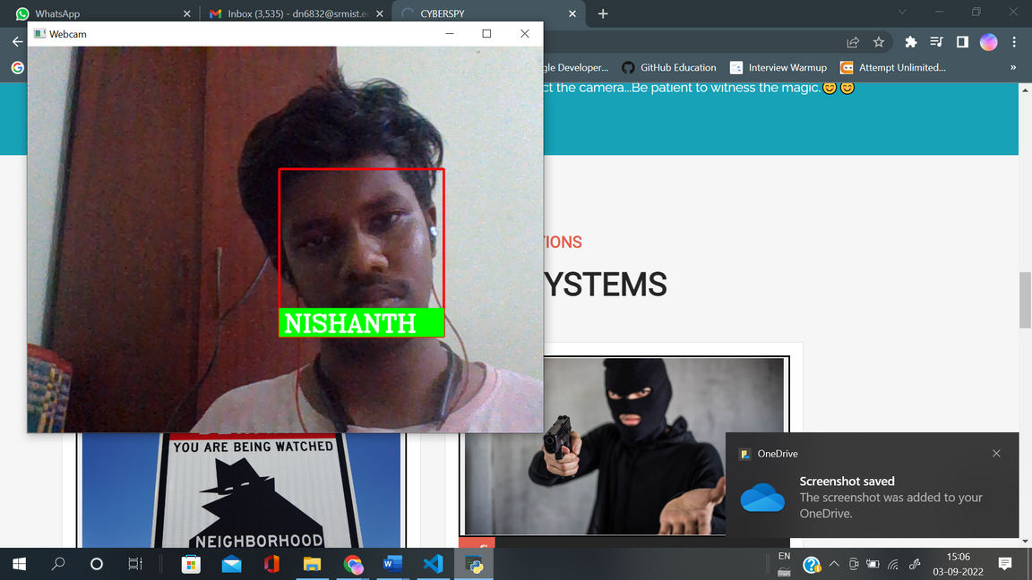
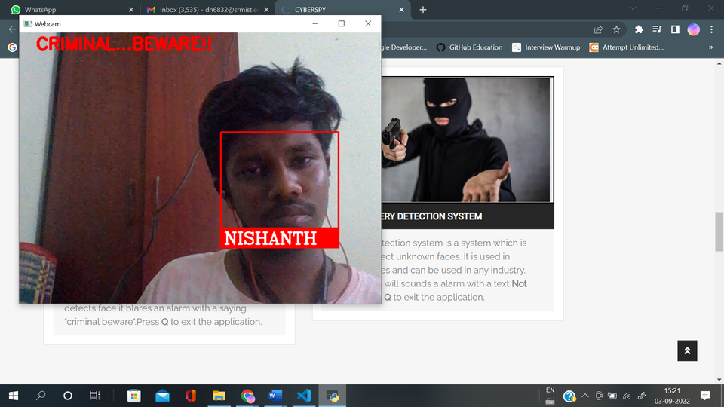
Cyberspy

Slide 38
REFERENCES

Slide 39
Title | Author | Citation
Writing Overview on Criminal Recognizable proof in Mumbai utilizing DBSCAN | Akshay Rathod, Rushikesh Sawant | Vol 12 No SUP 1 (2020): SAMRIDDHI: A Journal of Physical Sciences, Engineering and Technology.
Face Detection Techniques: A Review | Ashu Kumar, Amandeep Kaur | Artificial Intelligence Review 52(1) DOI:10.1007/s10462-018-9650-2
The system of face detection based on OpenCV | Xinghua Fan, Fuyou Zhang | 2012 24th Chinese Control and Decision Conference (CCDC), 2012, pp. 648-651, Doi: 10.1109/CCDC.2012.6242980.
Face detection and tracking: Using OpenCV | Kruti Goyal, Kartikey Agarwal | 2017 International conference of Electronics, Communication and Aerospace Technology (ICECA), 2017, pp. 474-478, Doi: 10.1109/ICECA.2017.8203730.
Real time face detection and tracking using opencv | Mamata s.Kalas | IRF International Conference, 5th & 6th February 2014, Pune India. ISBN: 978-93-82702-56-
A comparative study between LBP and Haar-like features for Face Detection using OpenCV | Kushsairy Kadir, Mohd Khairi Kamaruddin | 2014 4th International Conference on Engineering Technology and Technopreneuship (ICE2T), 2014, pp. 335-339, Doi: 10.1109/ICE2T.2014.7006273

Slide 40
Title | Author | Citation
Face detection based on adaboost | Jian-Ming Liao | 2009 International Conference on Apperceiving Computing and Intelligence Analysis, IEEE
Face Detection and Tracking using OpenCV | S.V. Viraktamath, Aditya Khatawkar | The Standard International Journals (The SIJ), ISSN: 2321 – 2403
Face Detection Method Research and Implementation Based on Adaboost | Dai Chen, Ji-lin Wang | 2010 International Symposium on Intelligence Information Processing and Trusted Computing, 2010, pp. 643-646, doi: 10.1109/IPTC.2010.125.
Research of AdaBoost Face Detection and OpenCV Implementation | H.W. Liu, G. Wang, and G.W. Zhang | AMM 2014;651–653:482–5. https://doi.org/10.4028/www.scientific.net/amm.651-653.482.
University Classroom Attendance Based on Deep Learning | Rong Fu, Dan Wang | 2017 10th International Conference on Intelligent Computation Technology and Automation (ICICTA), 2017, pp. 128-131, doi: 10.1109/ICICTA.2017.35.

Slide 41







Thank you for all your support!!!

